Slide 1

SAP Identity Authentication
Architecture Design
Wednesday, April 23, 2021

Slide 2
Authentication Process Overview
SAP IAS
Write user data*
PWD Users
SAP SuccessFactors, LMS, People Analytics
Authentication Proxy
SAP IPS
Read user data*
Username
Email
Last Name
ADFS
SSO Users
* During SuccessFactors Upgrade, an API User is created on both IAS and SF

Slide 3


Authentication Process for non-SSO Users
Browser
5
1- A browser client requests a web resource protected by a SAML SP (SP1)
2 – The client is redirected to IdP
3 – The client makes a SAML Authentication Request to SSO Service @ IDP1.
4 – IDP1 issues an assertion and returns a response to client
5 – The Client Submits the response to the ACS @ SP1
6– SP1 redirects the client to the resource
7 – The client requests the resource
8 – The resource makes an access control decision based on the security context established and the claims received in the SAML Auth Request
SP1
6
7
8
2
1
IDP1
4
3
4
Required claims in response: Username (Employee #)
User provided credentials

Slide 4

Authentication Process for SSO Users
Browser
11
1- A browser client requests a web resource protected by a SAML SP (SP1)
2 – The client is redirected to IdP
3 – The client makes a SAML Authentication Request to SSO Service @ IDP1.
4 – The client is redirected to the Corporate IdP (IDP2)
5 - The client makes a SAML Authentication Request to SSO Service @ IDP2.
6 – IDP2 issues an assertion and returns the SAML Auth Response to Client.
7 – The Client submits the response to the ACS at SP2.
8 – The SP2 redirects to IDP1
9 – The Client makes an Auth Request to IDP1: the same one as in step 3
10 – IDP1 issues an assertion and returns a response to client, with claims from IDP2 or additional ones from IAS.
11 – The Client Submits the response to the ACS @ SP1
12 – SP1 redirects the client to the resource
13 – The client requests the resource
14 – The resource makes an access control decision based on the security context established and the claims received in the SAML Auth Request
SP1
12
14
13
2
1
3
4
IDP1
9
10
7
SP2
8
5
IDP2
6
10
Required claims in response: Username (Employee #)
6
Required claims in response: Username (Employee #)
User provided credentials

Slide 5
Option 1: Same Link for everyone: Authentication Process
Reroute User Auth Request
SF Login Page
SAP IAS
IAS Conditional Authentication
User enters Employee Number
Redirects to IAS Login Page
Redirect Users assigned to PWD Groups to IAS Login Page
Redirect Users assigned to IdP Groups to The Corporate IdP Login Page
Write user data
SAP IPS
Assign users to appropriate groups
SAP IAS Local IdP
User enters his password
Read user data
SAP SuccessFactors, LMS, People Analytics
Corporate IdP
User enters his password
Redirect User to SF when Authentication is Successful

Slide 6
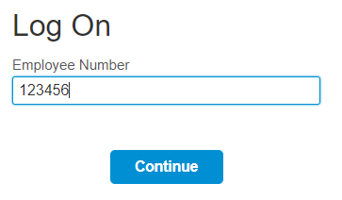
Option 1: Same Link for everyone: Authentication Process

Slide 7
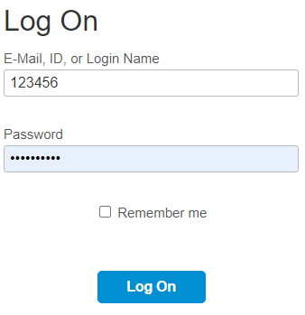
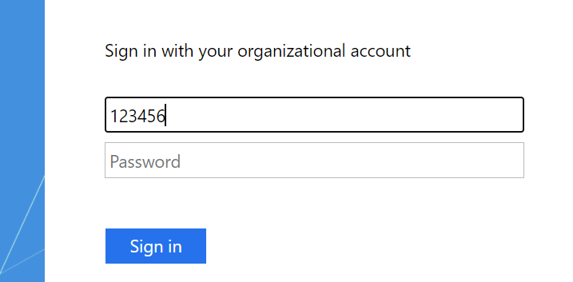
Option 1: Same Link for everyone: Authentication Process
IAS Login Page
ADFS Login Page
Or
Pros:
Login is done using the same SF link for all users.
Users on additional IdPs will also be able to use the same SF link to login.
Seamless for external workers and Users on the City’s Network
Cons:
ADFS Users will have to change the username when outside the network once on the ADFS login page.

Slide 8
Option 1: Same Link for everyone: Technical Notes
Set IAS as the Default IdP and establish requirements with authentication rules.
Which rules to use to identify which IdP to use?
Change management to ask employees to login with appropriate username format:
For SSO Users: use UPN / Employee #
For non-SSO Users: use Employee #
Users will be assigned to Multiple Groups during the sync process using IPS:
PWD: a group for password users with login method on their SF profile
Additional groups for other IDPs/Partners: VPL, VPD, Fire…
Same link will be used for all users (SuccessFactors link)
Consideration:
Are the users using email ID to login to ADFS? or just the network ID? How big of a change management is it to communicate with them to use Email IDs or employee IDs for login?

Slide 9
Option 2: Different Links per type of users : Authentication Process
Redirects to Lundins IdP Login Page
SF Login Link
SAP IAS
IAS Login Link for PWD Users
Redirect to IAS Login Page
Write user data
SAP IPS
Assign users to appropriate groups
SAP IAS Local IdP
User enters his credentials
Read user data
SAP SuccessFactors, LMS, People Analytics
Corporate IdP
User enters his credentials
Redirect User to SF when Authentication is Successful

Slide 10
Option 2: Different Links per type of users : Authentication Process
IAS Login Page
ADFS Login Page
userid@lundinmining.com
Or
Pros:
Lundin’s Employees can login with their ADFS credentials.
No complex dependencies on attributes to route login requests.
Cons:
PWD Users will login with a different link.
Users on Additional IdPs will login with a different link.

Slide 11
Option 2: Different Links per type of users : Technical Notes
Set Lundins ADFS as the Default IdP. Lundin’s ADFS will be SP-initiated
Additional Corporate IdPs will be IdP-initiated.
Multiple links will be used to login for different types of users.
Additional IdPs will need to provide the IdP-initiated link.

Slide 12
General Technical Notes
The Integration between SuccessFactors and IAS will disable Partial SSO.
Non-SSO Users will need to login through IAS login page.
For Non-SSO Users, Password is managed on the IAS Admin.
During the upgrade, an IPS tenant is created. Transformation scripts are created to map SF fields and source User's data into IAS:
Required fields: last name, email, unique username
An API admin user (IPSADMIN) is created on SuccessFactors and assigned appropriate roles.
Cannot undo the upgrade once it’s completed.

Slide 13
People Analytics Activation
Enabled through the Upgrade Center.
Embedded in SuccessFactors reporting.
Requires IAS to establish a session on SAP Cloud Analytics.
Requires setting up some Role Based Permissions.
Requires Provisioning configuration to activate SSO.

